Slide 1
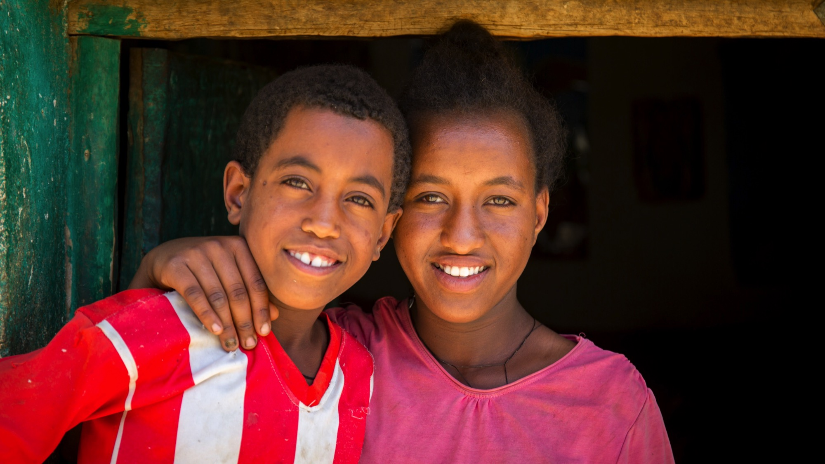
Stations
of the
Cross
A prayerful journey of transformation
Notes:
Image: Hanni and his sister Samrawit, who live in an area of Ethiopia that suffers severe drought most of the year.
Picture credit: Louise Norton/CAFOD

Slide 2
Let us pray together for God to transform our lives
and the lives of others.
Notes:
Opening reflection
Leader: As we reflect on the final journey of Jesus, leading to his death on the cross, we also contemplate the lives of our sisters and brothers around the world living in extreme poverty. People like those living in drought-stricken Ethiopia, featured on the CAFOD 2021 Lent appeal.
Let us pray together for God to transform our lives and the lives of others:
Loving God,
we hear your call to all who thirst for a brighter future: Come to the water.
Pour out your Spirit upon us and lead us to walk alongside one another.
Let a desire for change well up within us. May we overflow with compassion and love. And as a stream wears away stone, may we reshape our world together to reflect your kingdom of hope for all.

Slide 3
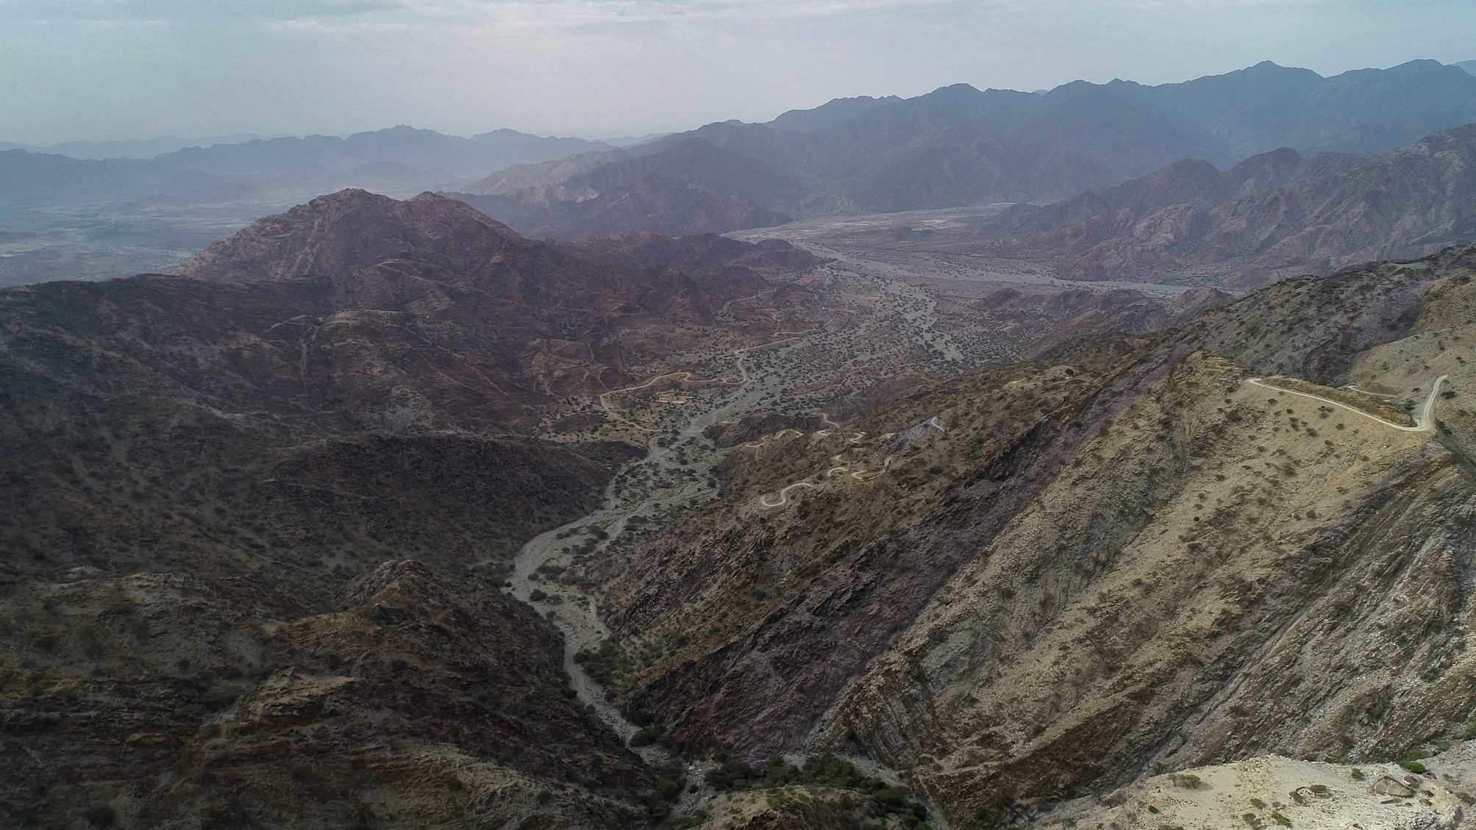
“…he handed him over to be crucified.”
Matthew 27:26
Notes:
Reader: “The governor again said to them, ‘Which of the two do you want me to release for you?’ And they said, ‘Barabbas’. Pilate said to them, ‘Then what should I do with Jesus who is called the Messiah?’ All of them said, ‘Let him be crucified!’… When Pilate saw that it was no use to go on, but that a riot might break out, he took some water and washed his hands in front of the crowd ….Pilate released Barabbas for the crowd; and after flogging Jesus, he handed him over to be crucified.”
Matthew 27:21-26
Leader: We adore you, O Christ, and we praise you,
All: because by your Holy Cross you have redeemed the world.
Reflect:
Jesus stands silent and composed as the crowd calls for his death. Pilate finds no guilt in Jesus, yet he is still condemned.
In our world today many are condemned to lives of hardship and poverty. Ethiopia has one of the lowest worldwide carbon footprints and yet is one of the countries most vulnerable to climate change. Many people are impacted by the severe drought this causes.
What is our response? Do we wash our hands of our brothers and sisters or seek to act in solidarity?
Prayer:
Jesus, you know what it means to stand alone
in front of those who reject you and don’t understand you.
Walk with us.
When we feel that we can’t make a difference, help us to keep going.
Teach us to share your love.

Slide 4
We adore you, O Christ, and we praise you
R/ Because by your Holy Cross you have redeemed the world.
Prayer
Jesus, you know what it means to stand alone
in front of those who reject you and don’t understand you.
Walk with us.
When we feel that we can’t make a difference,
help us to keep going.
Teach us to share your love.
Notes:
Image: The Danakil Depression in northeast Ethiopia, one of the hottest places on earth. Many of the people living in the region struggle each day to get enough water to drink.
Picture credit: Screengrab of drone footage.

Slide 5
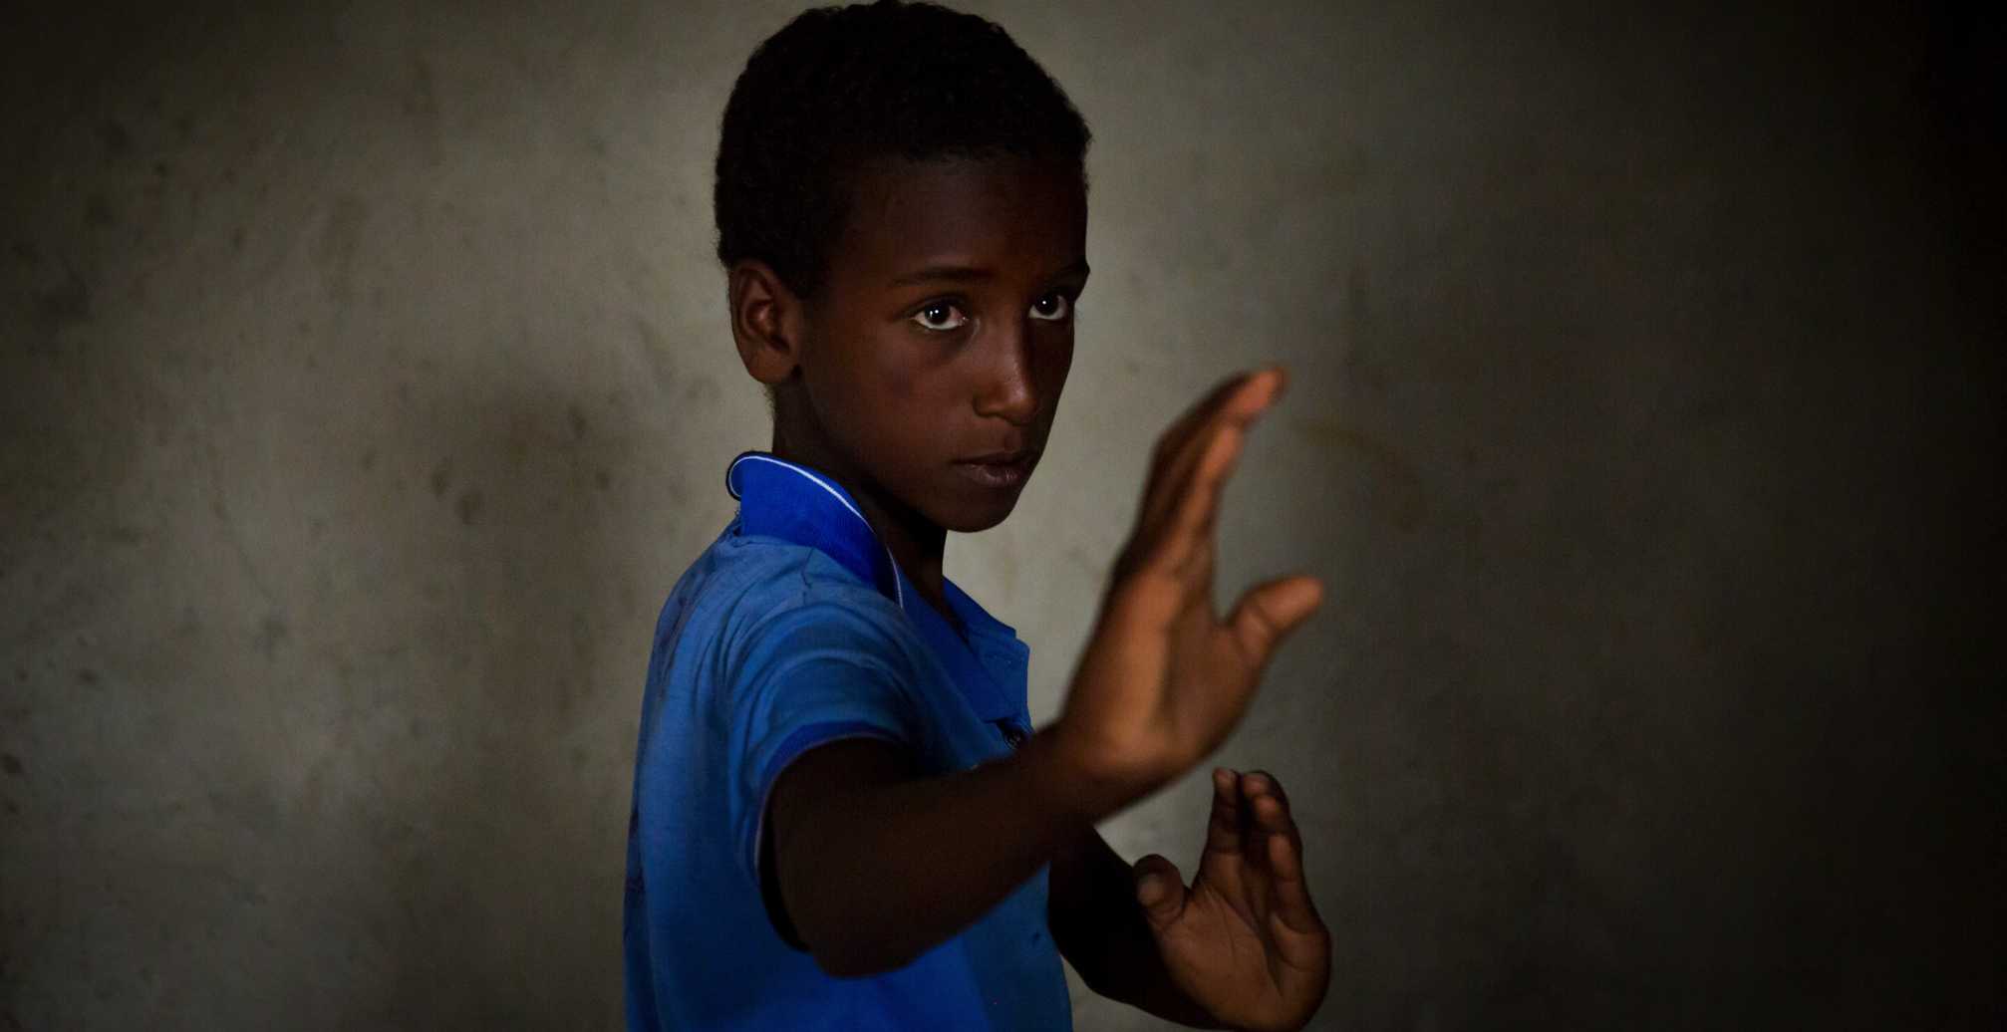
“Then they led him away to crucify him.” Matthew 27:31
Notes:
Reader: “After mocking Jesus, the soldiers stripped him of the robe and put his own clothes on him. Then they led him away to crucify him.” Matthew 27:28-31
Leader: We adore you, O Christ, and we praise you,
All: because by your Holy Cross you have redeemed the world.
Reflect: The guards dress Jesus up as a king, with a crown made of thorns, and mock him. They give him a heavy wooden cross to carry. Jesus knows that the way will not be easy and that it will lead to his death. And yet he shoulders his burden and starts on his way.
The burden of carrying water over long distances is one that too many people must bear, including children. Mohammed is 11 and twice each day must journey alone to fetch water. It takes him three hours.
“It’s so difficult,” he exclaims. “I always hope someone will help me one day. If nobody helps me in this life, maybe in the next life they will help me. I think a lot about the time when one day I will not have to do this.”
We all have burdens to carry. We also place burdens on others. In what ways do I place unnecessary loads on other people?
Prayer:
Jesus, your love led you to take up the cross.
Walk with us.
When we feel afraid, help us to be brave.
Give us the courage to speak out to change our world,
so that all our sisters and brothers
can experience justice.

Slide 6
We adore you, O Christ, and we praise you
R/ Because by your Holy Cross you have redeemed the world.
Prayer
Jesus, your love led you to take up the cross.
Walk with us.
When we feel afraid, help us to be brave.
Give us the courage to speak out to change our world,
so that all our sisters and brothers
can experience justice.
Notes:
Image: Mohammed, 11, who collects water from a dry riverbed every day. Here he is practising karate, which he loves.
Picture credit: Louise Norton/CAFOD

Slide 7
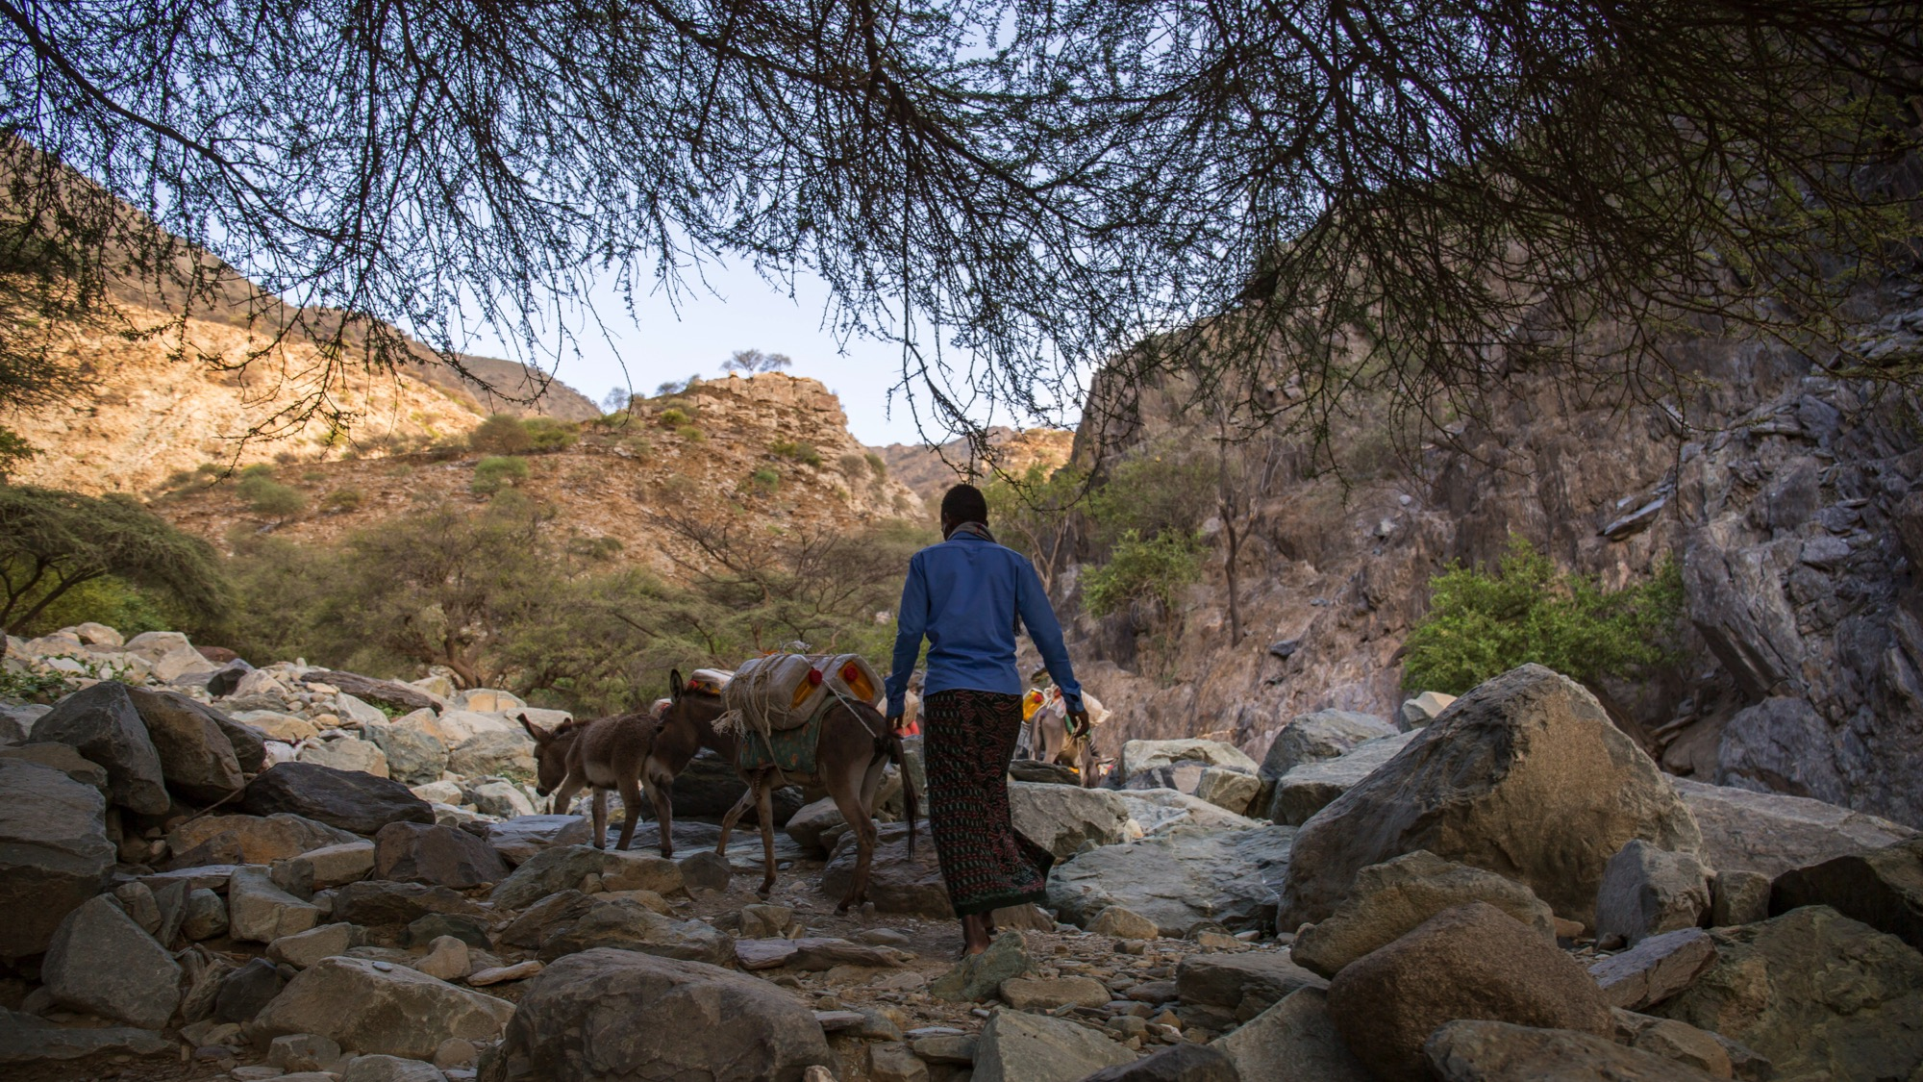
“…he was wounded for our transgressions”
Isaiah 53:3
Notes:
Reader: “He was wounded for our transgressions, crushed for our iniquities; upon him was the punishment that made us whole, and by his bruises we are healed.” Isaiah 53:5
Leader: We adore you, O Christ, and we praise you,
All: because by your Holy Cross you have redeemed the world.
Reflect: Burdened by his heavy cross, worn down by fatigue and pain, Jesus falls.
Abdella knows what it is to be totally exhausted. This young farmer who lives in northeast Ethiopia, one of the hottest parts of the world, must spend ten hours every day on the long walk to collect water for his family. Abdella says, “I don’t have any more words to express how hard this is. I’m so tired, I’m struggling to give you words. The journey for water is so long.”
The choices we make have an impact on other people both near and far. In what way do my choices cause others to stumble?
Prayer:
Jesus, you know how it feels to struggle and to fall.
Walk with us.
Show us how to walk with others
to know what it feels like to be in another’s shoes.
You reach out to us with caring hands.
Show us how to join our hands with communities around the world
who are bringing hope to their people.

Slide 8
We adore you, O Christ, and we praise you
R/ Because by your Holy Cross you have redeemed the world.
Prayer
Jesus, you know how it feels to struggle and to fall.
Walk with us.
Show us how to walk with others,
to know what it feels like to be in another’s shoes.
You reach out to us with caring hands.
Show us how to join our hands with communities around the world
who are bringing hope to their people.
Notes:
Image: Abdella, 23 climbs a mountain to collect water for his family. He makes two journeys to collect the water each day. Each journey takes 5 hours. Picture credit: Mark Chamberlain/CAFOD

Slide 9
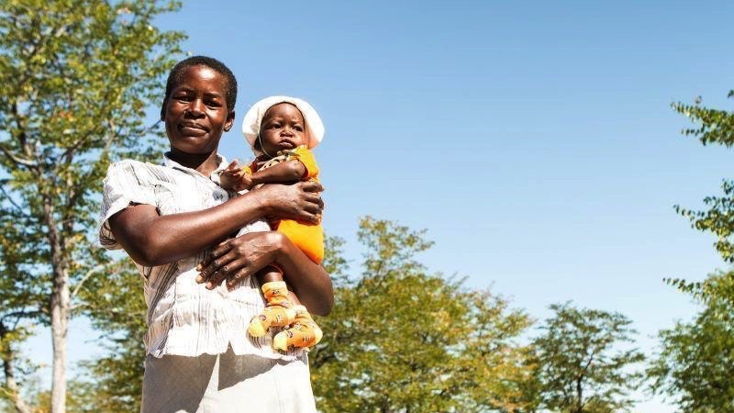
“…a sword will pierce your own soul too.” Luke 2:34
Notes:
Reader: “Then Simeon blessed them and said to his mother Mary, ‘This child is destined for the falling and the rising of many in Israel, and to be a sign that will be opposed so that the inner thoughts of many will be revealed – and a sword will pierce your own soul too.” Luke 2:33-35
Leader: We adore you, O Christ, and we praise you,
All: because by your Holy Cross you have redeemed the world.
Reflect:
This was the fulfilment of Simeon’s prophecy, the sword that ran through Mary’s soul. She who nurtured Jesus as a baby, witnessed his first steps and words, now meets her son on this final journey. What pain Mary must have felt, unable to reach out to help or comfort Jesus. Yet she remains present and steadfast.
So many mothers throughout the world grieve; with empty hands unable to feed their hungry children or get medicine and care for their families.
Let us look to the example of Mary and not turn our faces away from those who are suffering.
Prayer:
Jesus, you looked through the crowd
and saw your mother’s eyes.
Her love gave you the strength to carry on.
Walk with us.
When we don’t want to listen, open our ears to hear.
When it would be easier to look away, open our eyes to see.

Slide 10
We adore you, O Christ, and we praise you
R/ Because by your Holy Cross you have redeemed the world.
Prayer
Jesus, you looked through the crowd
and saw your mother’s eyes.
Her love gave you the strength to carry on.
Walk with us.
When we don’t want to listen,
open our ears to hear.
When it would be easier to look away,
open our eyes to see.
Notes:
Image: Delinah and her son Muzina in Zimbabwe. Delinah’s baby was identified as being severely malnourished at a mobile health clinic. Seven-month-old Muzina was given an emergency nutrition paste made from peanuts and Delinah was encouraged to join a CAFOD-supported local support group for mothers where she can learn about good nutrition for her baby,
Picture credit: Thom Flint/ CAFOD

Slide 11
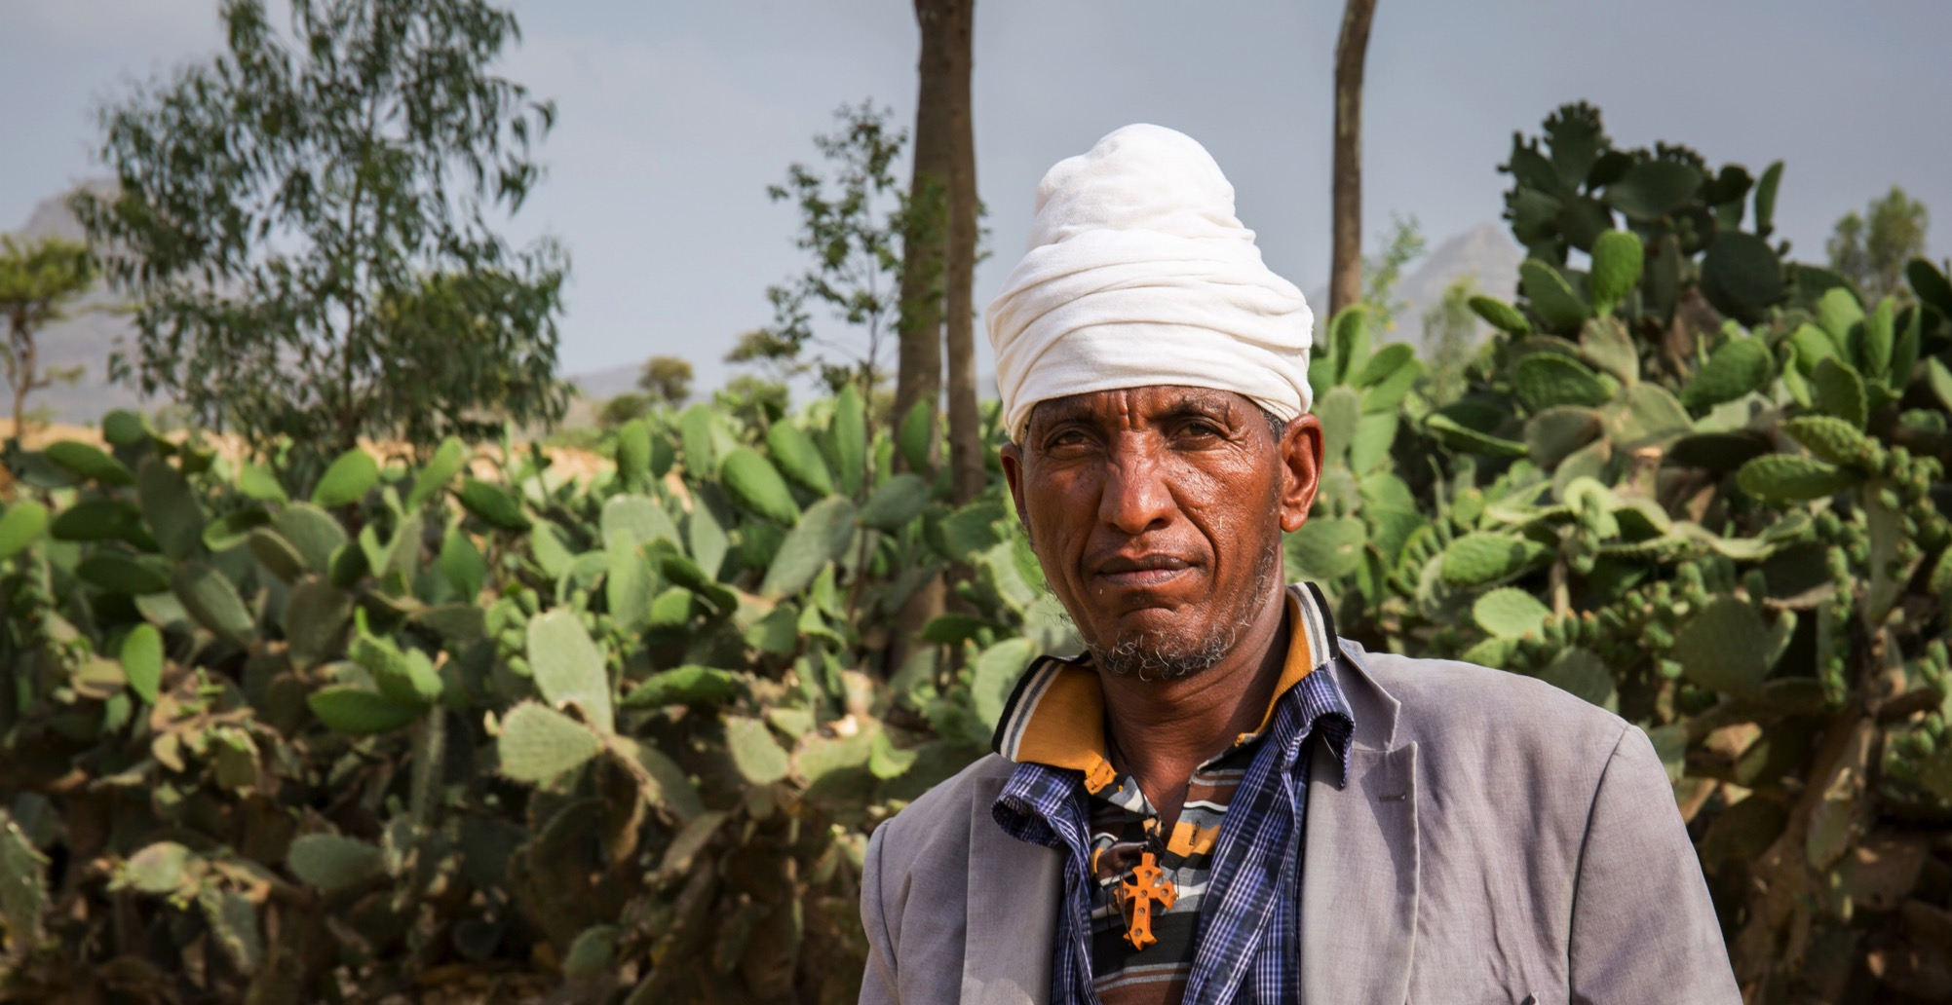
“The soldiers compelled a passer-by…
to carry his cross.” Mark 15:21
Notes:
Reader: “The soldiers compelled a passer-by, who was coming in from the country, to carry his cross; it was Simon of Cyrene, the father of Alexander and Rufus.” Mark 15:21
Leader: We adore you, O Christ, and we praise you,
All: because by your Holy Cross you have redeemed the world.
Reflect: Simon of Cyrene comes into the city of Jerusalem on the day of Jesus’ death. He finds himself in the crowds along Jesus’ pathway to Golgotha and is enlisted to help carry his cross. He does not know Jesus but lends his strength to carrying the heavy weight of the wood.
Abba Tesfalem lives in northern Ethiopia, in an area prone to severe droughts. There is very little paid work available and it is often a struggle to support his family. At one point he was forced to take a loan just to buy bread for them to survive. Despite his own hardship, Abba Tesfalem still reaches out in generosity and kindness to others in need.
“Another family we know, I gave some money to them. They didn’t have enough and they had big problems. I had to help them and they bought bread.”
Do we look for opportunities to help others, or do we try to keep out of the way, telling ourselves that it is not our responsibility?
Prayer:
Jesus, you know what it means to depend on someone and to need their help.
Walk with us.
When my friends need help, teach me to work with them to lighten their load.
Show me how to listen carefully so that I can offer what they need.
We are your global family of many different colours, cultures and religions.
Make us one family united in you.

Slide 12
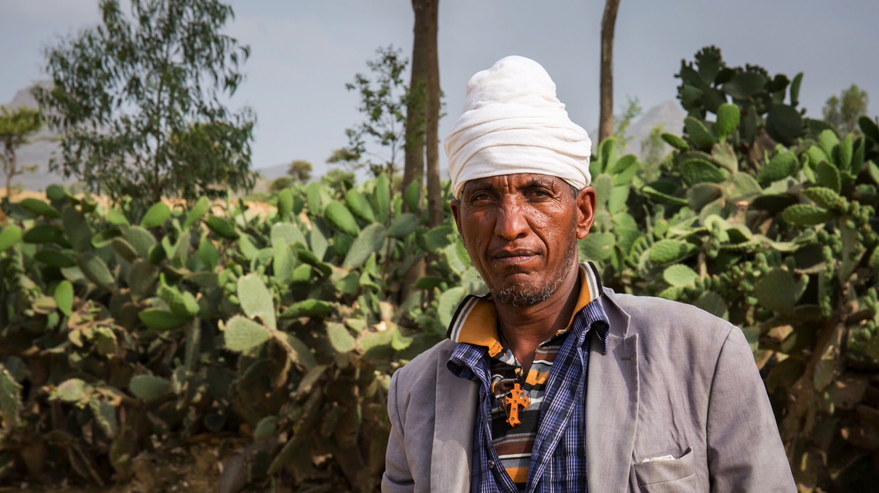
We adore you, O Christ, and we praise you
R/ Because by your Holy Cross you have redeemed the world.
Prayer
Jesus, you know what it means
to depend on someone and to need their help.
Walk with us.
When my friends need help,
teach me to work with them to lighten their load.
Show me how to listen carefully so that I can offer what they need.
We are your global family of many different colours, cultures and religions.
Make us one family united in you.
Notes:
Image: Abba Tesfalem, an Ethiopian Orthodox priest, who lives in an area of severe drought and and must do several jobs to support his family.
Picture credit: Louise Norton/CAFOD

Slide 13
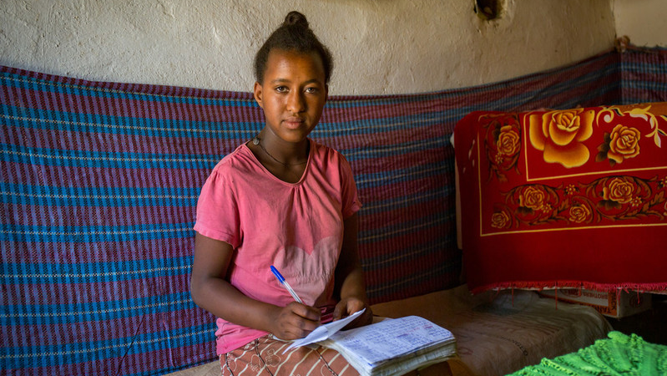
“Just as you did this to one of the least of these, you did it to me” Mark 25:40
Notes:
Reader: “And the king will answer them, ‘Truly I tell you, just as you did it to one of the least of these who are members of our family, you did it to me.’” Matthew 25:37-40
Leader: We adore you, O Christ, and we praise you,
All: because by your Holy Cross you have redeemed the world.
Reflect:
Moved by Jesus’ pain, Veronica’s love overcomes her fear and she courageously steps forward to wipe the blood and sweat from Jesus’ face. She cannot change his fate, but recognising his dignity, she faithfully performs her small act of compassion. As the guards force Jesus onward, the image of his face is left on Veronica’s veil.
We too are called to compassion. It is easy to be discouraged by the scale of poverty and need in the world, but each day offers us the opportunity to perform small acts of kindness and generosity. In doing so we recognise the face of Jesus in our neighbour and he imprints his face on each of us.
Do we look for opportunities to do small acts of generosity and love? Are we attentive to the face of Christ in our brothers and sisters?
Prayer:
Jesus, you know how it feels
to be hurt and to cry out in pain and fear.
Walk with us.
Show us how to walk together with others.
Show us how to love the people around us
And to be there for those who need us.

Slide 14
We adore you, O Christ, and we praise you
R/ Because by your Holy Cross you have redeemed the world.
Prayer
Jesus, you know how it feels
to be hurt and to cry out in pain and fear.
Walk with us.
Show us how to walk together with others.
Show us how to love the people around us
And to be there for those who need us.
Notes:
Image: Thirteen year old Samrawit lives in a part of Ethiopia that suffers from severe drought most of the year. Many people in the area struggle to get enough food to eat.
Picture credit: Louise Norton/CAFOD

Slide 15
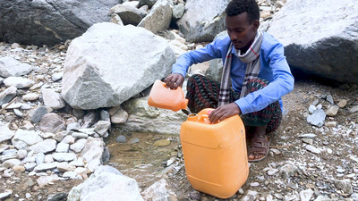
“Come to me all you who labour,
and I will give you rest.” Matthew 11:28
Notes:
Reader: “Come to me all you who labour, and I will give you rest. Take my yoke upon you, and learn from me; for I am gentle and lowly in heart, and you will find rest for your souls. For my yoke is easy and my burden light.” Matthew 11:28-30
Leader: We adore you, O Christ, and we praise you,
All: because by your Holy Cross you have redeemed the world.
Reflect:
Under the weight of the cross, Jesus is once again brought to his knees. After this second fall, Jesus’ struggle to rise up again is much harder.
We think of the people of Ethiopia, many of whom have faced poor harvest after poor harvest due to droughts. They show great resilience and strength in continuing to work for a better future. We think of those who are struggling to hold onto hope, due to the daily struggle against natural disasters and lack of opportunity.
How can we live in solidarity with those who feel despondent or invisible?
Prayer:
Jesus, you stumbled and fell.
You lost strength and became tired.
And yet you carried on.
Walk with us.
When we find it hard to keep going,
give us the strength we need
to finish our work as well as we can
and show love to others.

Slide 16
We adore you, O Christ, and we praise you
R/ Because by your Holy Cross you have redeemed the world.
Prayer
Jesus, you stumbled and fell.
You lost strength and became tired.
And yet you carried on.
Walk with us.
When we find it hard to keep going,
give us the strength we need
to finish our work as well as we can
and show love to others.
Notes:
Image: Abdella finally reaches the small puddle from which he must painstakingly collect water. The water quality is poor and can make people sick, but it is all that is available.
Picture credit: Mark Chamberlain/ CAFOD

Slide 17
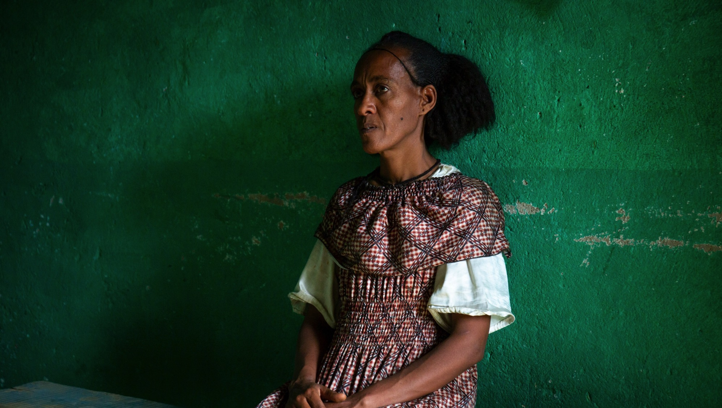
“women…were beating their breasts and wailing for him.” Luke 23:28
Notes:
Reader: “A great number of the people followed him, and among them were women who were beating their breasts and wailing for him.” Luke 23:27-28
Leader: We adore you, O Christ, and we praise you,
All: because by your Holy Cross you have redeemed the world.
Reflect: As Jesus draws closer to the place of execution, he encounters the women of Jerusalem weeping for him. There is a shared empathy here as Jesus recognises their difficulties and tells them not to weep for him, but for themselves and their children.
As we recall this exchange, we remember the many societies where women face huge challenges. Almaz lives in northern Ethiopia, where drought and lack of safe water are daily problems. She reflects; “The role of the woman in the home is very difficult. So difficult. All the activities in the home belong to me. I have to get food for my children and my husband – even preparing their clothes, washing. To get water, we travel long distances. When we gather, there are many people at the water point and you wait your turn, many times about five hours.”
What causes us to weep? Which situations in the world make us cry out to God?
Prayer:
Jesus, you cared and spoke out, even on the road to your death.
You knew and felt the struggles of others.
Walk with us.
As we hear the stories of our sisters and brothers who live in poverty,
give us the courage to raise our voices, so that together we can work for change.

Slide 18
We adore you, O Christ, and we praise you
R/ Because by your Holy Cross you have redeemed the world.
Prayer
Jesus, you cared and spoke out,
even on the road to your death.
You knew and felt the suffering of others.
Walk with us.
As we hear the stories
of our sisters and brothers who live in poverty,
give us the courage to raise our voices,
so that together we can work for change.
Notes:
Image: Almaz lives in area of northern Ethiopia that suffers severe drought most of the year.
Picture credit: Louise Norton/ CAFOD

Slide 19
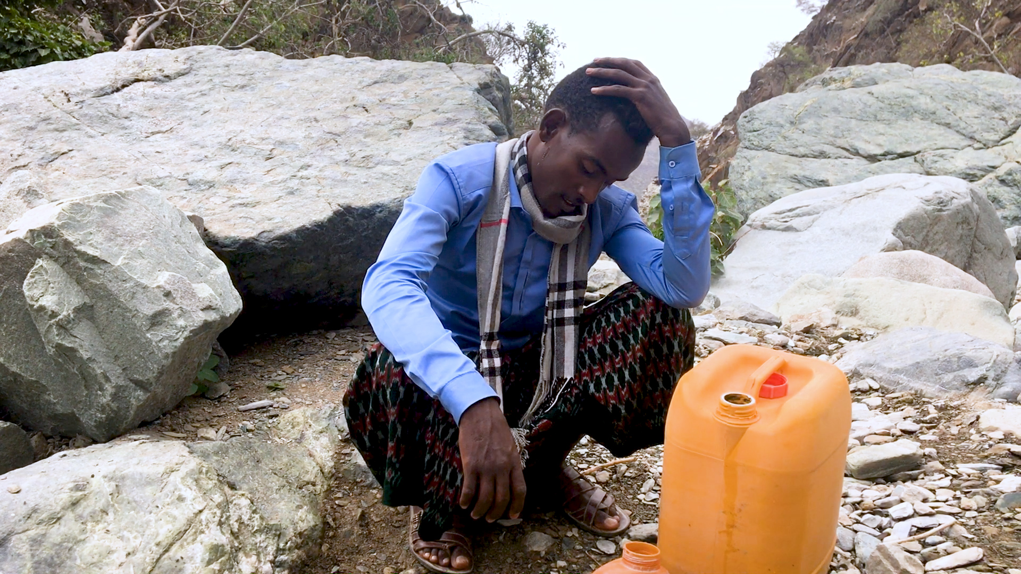
“For nothing will be impossible with God.”
Luke 1:37
Notes:
Reader: “For nothing will be impossible with God.” Luke 1:37
Leader: We adore you, O Christ, and we praise you,
All: because by your Holy Cross you have redeemed the world.
Reflect: Jesus falls a third and final time. He must surely now be completely drained, and yet he finds the strength to rise and continue on his path to Calvary.
Sometimes we may feel overwhelmed by difficulties; illness, caring responsibilities, loneliness, anxiety, our own moments of weakness and failure. Sometimes the challenges of facing our global family - climate change, poverty and injustice - can feel overwhelming, impossible to address.
Love gave Jesus the strength to stand again and continue onwards. We pray for ourselves, and for all those who need strength and courage, that in the face of so many struggles, the love of Christ will urge us on.
Prayer:
Jesus, you felt the darkness around you,
the crowds surrounded you.
You fell once more.
Walk with us.
When we lose hope, when everything is just too difficult,
show us how to reach out to each other and hold hands, so that none of us have to do everything on our own.
Help us to know that you walk alongside us even when we feel most alone.

Slide 20
We adore you, O Christ, and we praise you
R/ Because by your Holy Cross you have redeemed the world.
Prayer
Jesus, you felt the darkness around you,
the crowds surrounded you.
You fell once more.
Walk with us.
When we lose hope, when everything is just too difficult,
show us how to reach out to each other and hold hands,
so that none of us have to do everything on our own.
Help us to know that you walk alongside us
even when we feel most alone.
Notes:
Image: Abdella, 23 pauses on his long journey to collect water.
Picture credit: Mark Chamberlain/ CAFOD

Slide 21
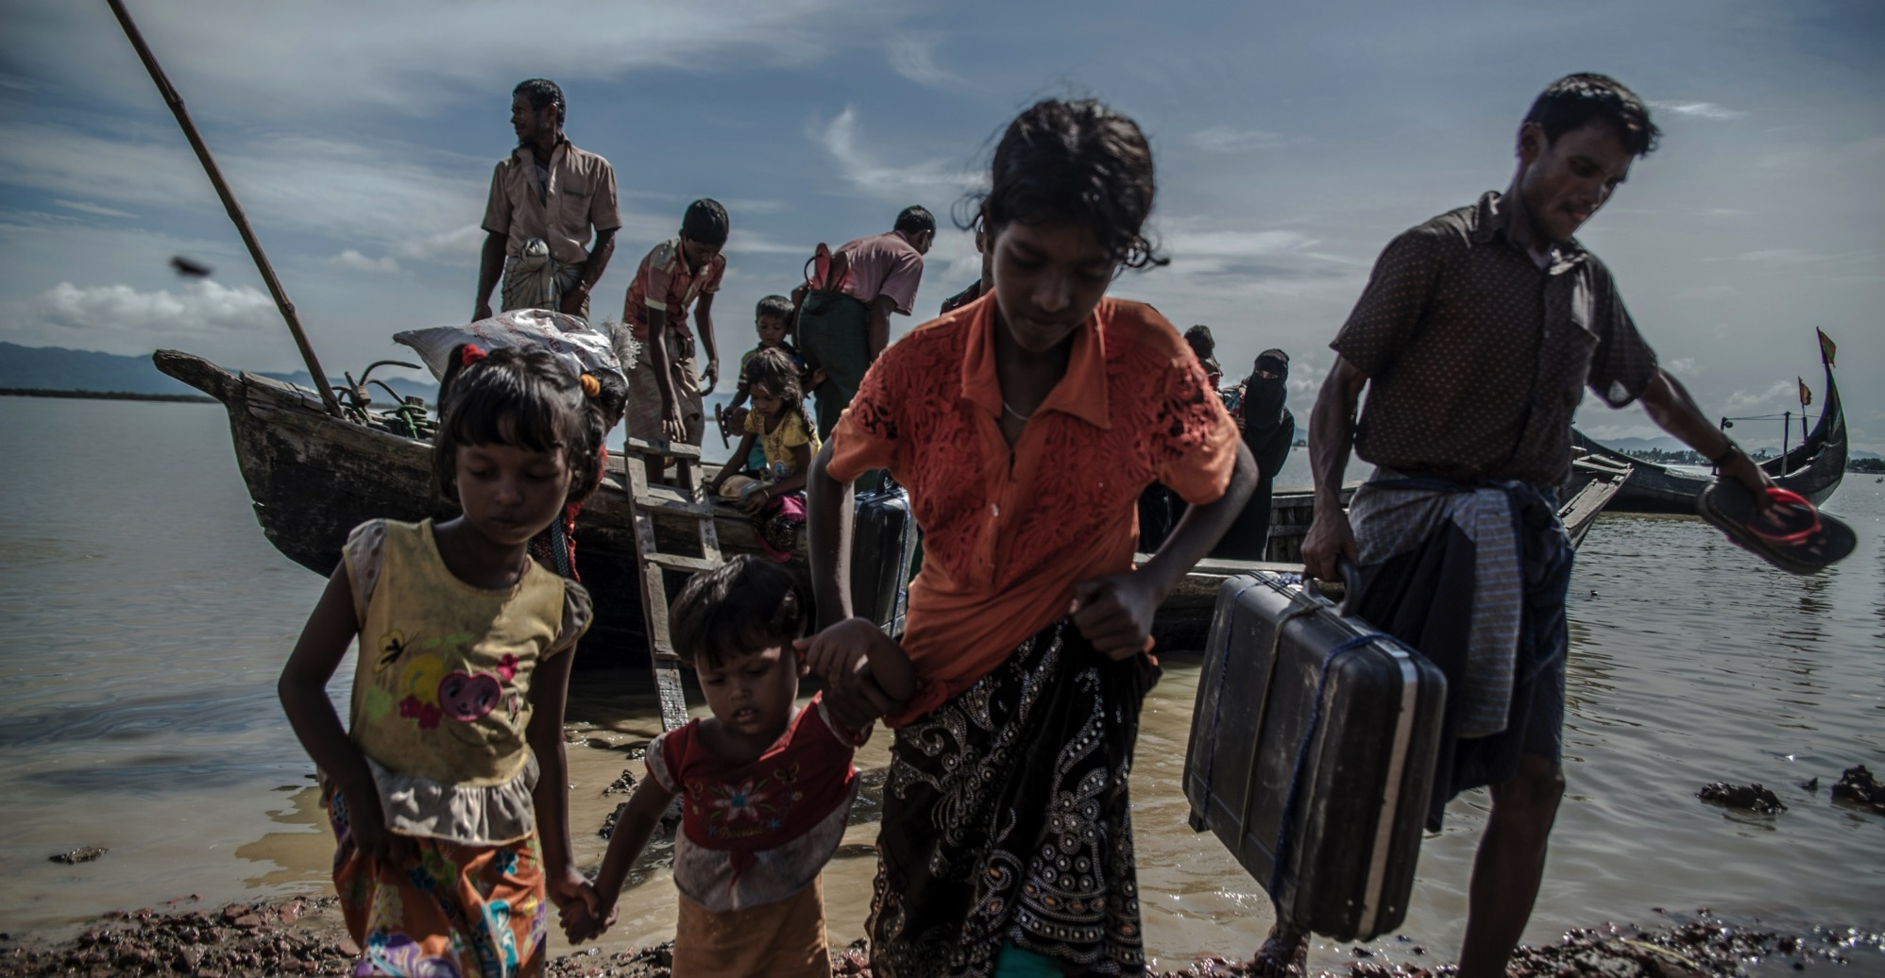
“The soldiers took his clothes.”
John 19:23
Notes:
Reader: “The soldiers took his clothes and divided them into four parts, one for each soldier. They also took his tunic…”
John 19:23-24
Leader: We adore you, O Christ, and we praise you,
All: because by your Holy Cross you have redeemed the world.
Reflect: Jesus has nothing left. Arriving at his place of execution, even his clothes are taken from him. Stripped of his dignity he holds nothing back.
The refugees of our world have been stripped of their homes, their families, their communities, their hopes for the future. Often they face the added difficulty of being met with hostility and mistrust when they try to make a new home in a safer place.
Do we recognise the dignity of all human life? What am I being called to do for those who have been stripped of so much?
Prayer:
Jesus, you sacrificed everything and endured mockery for our sake.
Walk with us.
When we value possessions more than people,
or look down on someone who has less,
show us your face in theirs.

Slide 22
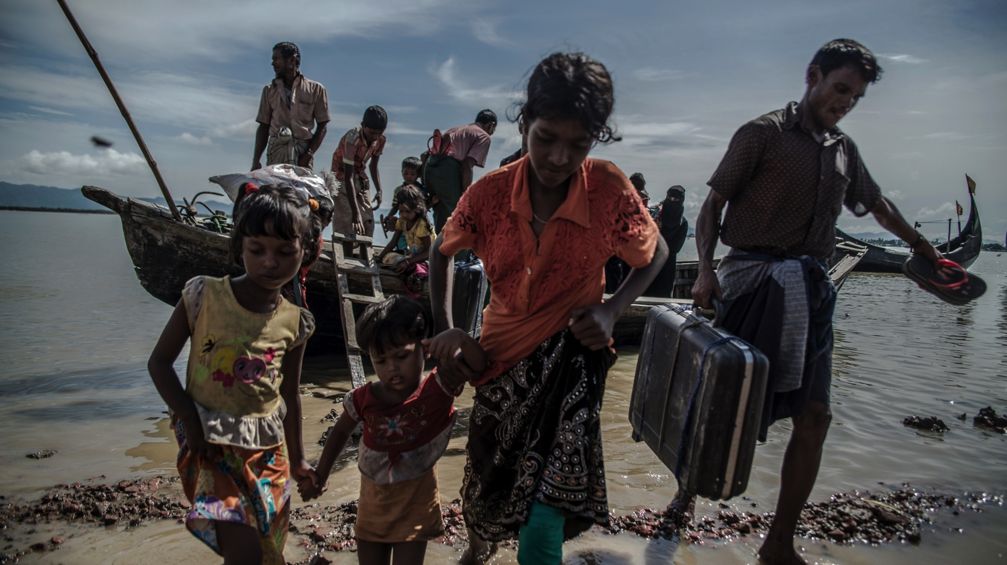
We adore you, O Christ, and we praise you
R/ Because by your Holy Cross you have redeemed the world.
Prayer
Jesus, you sacrificed everything
and endured mockery for our sake.
Walk with us.
When we value possessions more than people,
or look down on someone who has less,
show us your face in theirs.
Notes:
Image: A group of Rohingya refugees help each other ashore, on the Teknaf peninsula, Bangladesh, after crossing the Naf river from Myanmar the previous night. Picture credit: Aurélie Marrier d'Unienville/ Caritas

Slide 23
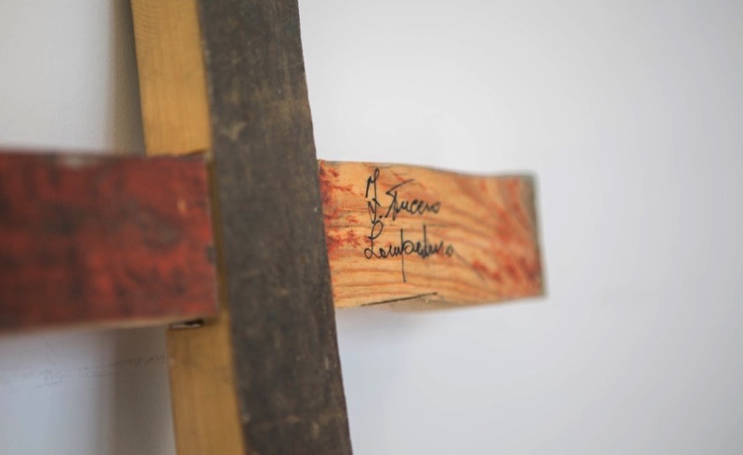
“Father, forgive them,
they know not what they do.” Luke 23:35
Notes:
Reader: “When they came to the place that is called The Skull, they crucified Jesus there with the criminals, one on his right and one on his left. Then Jesus said, ‘Father, forgive them, they know not what they do.’” Luke 23:33-35
Leader: We adore you, O Christ, and we praise you,
All: because by your Holy Cross you have redeemed the world.
Reflect: The soldiers drive the nails into Jesus’ hands and feet. Yet even in this moment he shows his compassion, praying for those who crucify him.
Jesus continues to be crucified in all who suffer in our world. He is present in those whom society marginalises; people who are hungry or homeless, refugees or asylum seekers. He is crucified in the exploitation of our common home, the earth and its resources.
As followers of Jesus, may we show his compassion and so be a source of hope for all our brothers and sisters, our global family, and our common home, the earth.
Prayer:
Jesus, you cry out in pain.
Walk with us.
Challenge us -
when we hold people back,
when we don’t treat them with respect.
Help us to remember that everyone is equal,
that we are all made in the image of God.

Slide 24
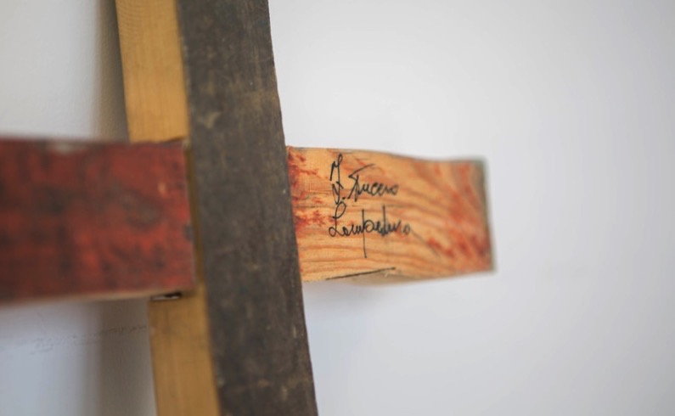
We adore you, O Christ, and we praise you
R/ Because by your Holy Cross you have redeemed the world.
Prayer
Jesus, you cry out in pain.
Walk with us.
Challenge us -
when we hold people back,
when we don’t treat them with respect.
Help us to remember that everyone is equal,
that we are all made in the image of God.
Notes:
Image: Three years ago, a boat set sail from Africa towards Europe, filled with over 500 refugees who were fleeing Eritrea and Somalia. On the way, the boat caught fire, capsized and sank near the island of Lampedusa; 311 people perished. Inhabitants of the island helped save the lives of 155 people. Francesco Tuccio, a carpenter on this Italian island, collected the broken pieces of wood that had washed ashore and crafted crosses to offer a small but powerful symbol of hope for each of the survivors. The Lampedusa Cross is a story of solidarity and love.
Picture credit: Ben White

Slide 25
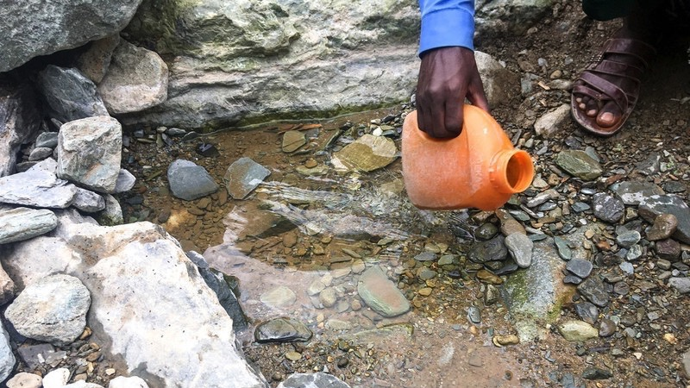
“I am thirsty.” John 19:28
Notes:
Reader: “Later, knowing that everything had now been finished, and so that Scripture would be fulfilled, Jesus said, ‘I am thirsty.’ A jar of wine vinegar was there, so they soaked a sponge in it, put the sponge on a stalk of the hyssop plant, and lifted it to Jesus’ lips. When he had received the drink, Jesus said, ‘It is finished.’ With that, he bowed his head and gave up his spirit.” John 19:28-30
Leader: We adore you, O Christ, and we praise you,
All: because by your Holy Cross you have redeemed the world.
Reflect: Just before he dies on the cross, Jesus cries out that he is thirsty. We can hear him continue to say these words to us, in our brothers and sisters who each day must strive for enough water simply to survive. These last words of Jesus challenge us. They call us to see his face in all those who thirst and to reach out to them in love. They invite us to make the connections between how we live as individuals and nations and the devastating effect climate change is having on our vulnerable world.
Prayer:
Jesus, you know what it’s like to feel alone,
lost and afraid, betrayed and abandoned.
Walk with us.
And show us how to walk with others,
who live in fear and face death through hunger, thirst and conflict.
Show us how to pray for sisters and brothers that we have never met,
but who are always loved by you.

Slide 26
We adore you, O Christ, and we praise you
R/ Because by your Holy Cross you have redeemed the world.
Prayer
Jesus, you know what it’s like to feel alone,
lost and afraid, betrayed and abandoned.
Walk with us.
And show us how to walk with others,
who live in fear and face death through hunger, thirst and conflict.
Show us how to pray for sisters and brothers that we have never met,
but who are always loved by you.
Notes:
Image: Abdella collects water in a jerrycan from a small dirty pool. Ethiopia.
Picture credit: Mark Chamberlain/ CAFOD

Slide 27
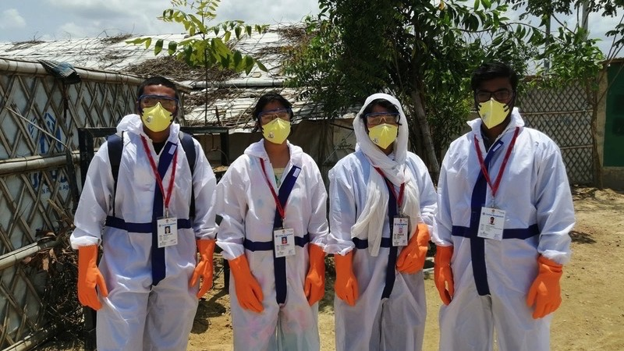
“Pilate gave him permission so he came and removed the body.” John 19:28
Notes:
Reader: “Joseph of Arimathea, who was a disciple of Jesus, though a secret one because of his fear of the Jews, asked Pilate to let him take away the body of Jesus. Pilate gave him permission; so he came and removed the body.” John 19:38
Leader: We adore you, O Christ, and we praise you.
All: because by your Holy Cross you have redeemed the world.
Reflect: The bodies of those crucified were usually left on the cross to decay. Joseph of Arimathea has been a secret follower of Jesus, but now he finds the courage to go to Pilate and ask for Jesus’ body. He acts despite the fear he must have felt, in order to ensure the lifeless body of his teacher is, at least now, treated with dignity and gentleness.
We pray that at times of difficulty we too will choose to do what is right. That we will commit to compassion and uphold dignity.
Prayer:
Jesus, you knew what it meant to have friends,
who risked their own lives to take your body from the cross.
Walk with us.
Show us how to be friends to those close to us and to those far away.
Teach us to see you in everybody,
to be kind, loving and strong.
To be like you.

Slide 28
We adore you, O Christ, and we praise you
R/ Because by your Holy Cross you have redeemed the world.
Prayer
Jesus, you know what it means to have friends,
who risked their own lives to take your body from the cross.
Walk with us.
Show us how to be friends to those close to us and to those far away.
Teach us to see you in everybody,
to be kind, loving and strong.
To be like you.
Notes:
Image: Caritas Bangladesh staff, wearing PPE, have been providing water points and hygiene kits and sharing messages in Cox’s Bazar camp to protect Rohingya refugees from the spread of coronavirus.
Picture credit: Ginea/Caritas Bangladesh

Slide 29
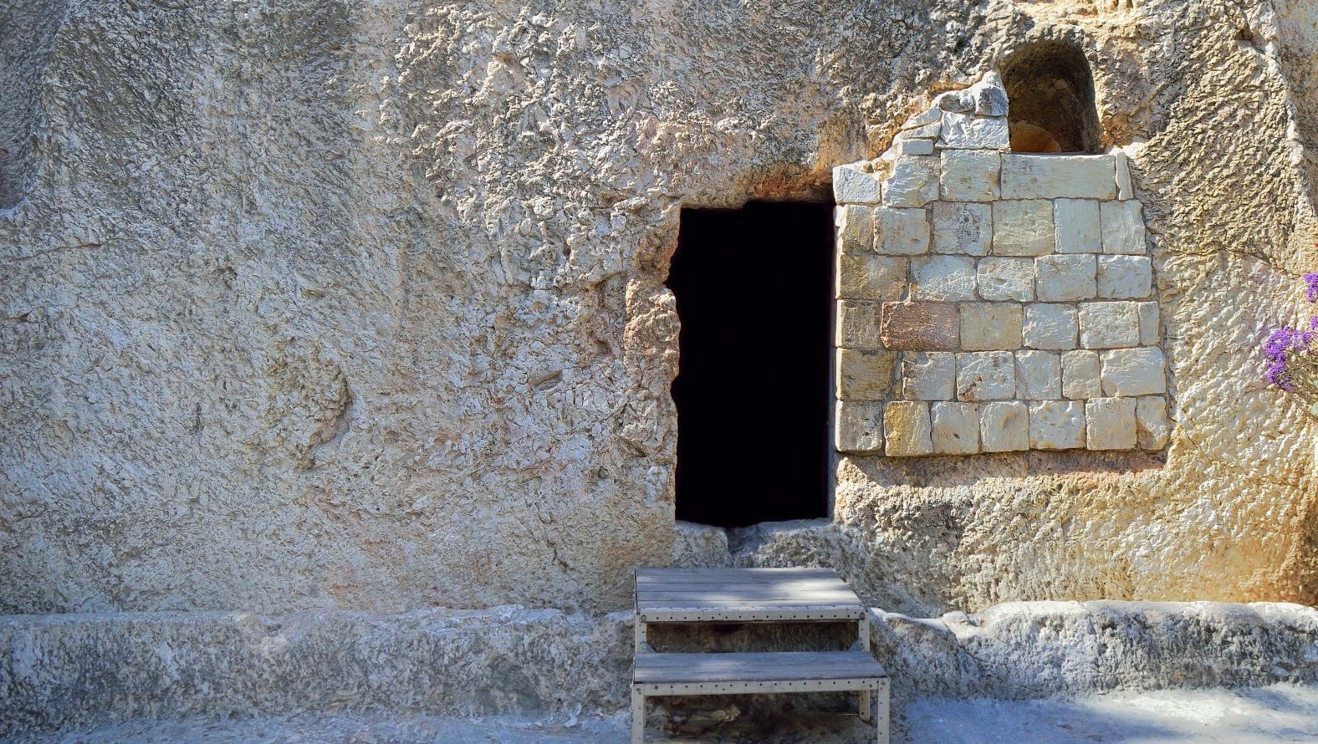
“He rolled a stone against the door of the tomb.” Mark 15:45-47
Notes:
Reader: “Joseph bought a linen cloth, and taking down the body, wrapped it in the linen cloth, and laid it in a tomb that had been hewn out of the rock. He then rolled a stone against the door of the tomb. Mary Magdalene and Mary the mother of Joseph saw where the body was laid.” Mark 15: 45-47
Leader: We adore you, O Christ, and we praise you,
All: because by your Holy Cross you have redeemed the world.
Reflect: There has been little time to prepare Jesus’ body for burial. Joseph has to move quickly to place it in the tomb before the Sabbath begins. He wraps it a simple linen cloth and rolls the stone over the door. The disciples have scattered in fear and grief and it seems like the end.
We too must act quickly if we are to protect our common home, the earth, for future generations. We pray that we may have a sense of urgency and hope, even in dark times, as we seek to make a difference.
Prayer:
Jesus, as you were sealed in the tomb
those who loved you felt sad and alone.
They did not know what to do.
Walk with us.
Guide us in difficult times,
so that we can share you with our sisters and brothers when they feel sad and alone.

Slide 30
We adore you, O Christ, and we praise you
R/ Because by your Holy Cross you have redeemed the world.
Prayer
Jesus, as you were sealed in the tomb
those who loved you felt sad and alone.
They did not know what to do.
Walk with us.
Guide us in difficult times,
so that we can share you with our sisters and brothers
when they feel sad and alone.
Notes:
Image: Garden Tomb in Jerusalem, one of two sites proposed as the place of Jesus’ burial.
Picture credit: Manuel F-O/ istock

Slide 31
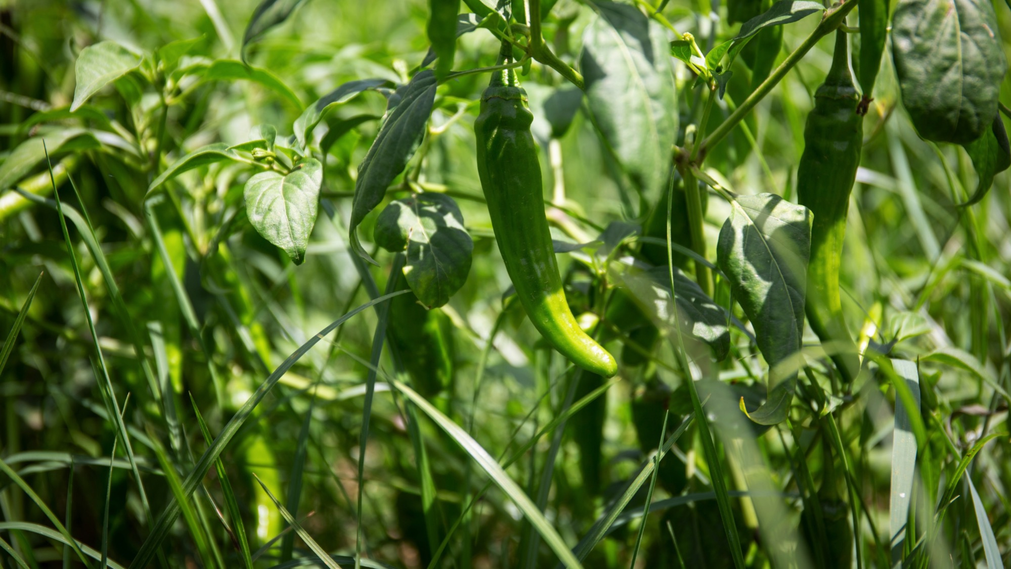
“He is not here, but has risen.” Luke 24:5
Notes:
Reader: “Why do you look for the living among the dead? He is not here, but has risen.” Luke 24:5
Leader: We adore you, O Christ, and we praise you,
All: because by your Holy Cross you have redeemed the world.
Reflect: Jesus is alive. He has conquered death and is here among us.
His resurrection opens the way of hope and assures us that injustice, pain and death can be overcome.
As we reflect on Jesus’ final journey, we pray for the strength to live each day as people transformed through God’s love. May we radiate God’s love to all of creation.
Prayer:
Jesus, you share your life, your light and your peace with us all.
Walk with us.
Show us how to live out your love
so that our sisters and brothers,
here and around the world,
may know the joy of new life.
May we all be changed by living in your light.

Slide 32
We adore you, O Christ, and we praise you
R/ Because by your Holy Cross you have redeemed the world.
Prayer
Jesus, you share your life, your light and your peace with us all.
Walk with us.
Show us how to live out your love
so that our sisters and brothers,
here and around the world,
may know the joy of new life.
May we all be changed by living in your light.
Notes:
Image: Crops grown in northern Ethiopia, using a new solar water pump and irrigation system to cultivate the land. This has lifted families out of poverty and given new hope. Picture credit: Louise Norton/CAFOD

